Slide 1
Breast cancer signs and prediction
Chung-I Huang/ 2018-12-05

Slide 2
Abstract
I am using sklearn dataset’s breast cancer data to figure out what symbols are more associated to breast cancer (benign or malignant)? The approaches I am applying for are DecisionTreeClassifier, KNN, and KMeans. The 1st & 2nd belong to the ‘supervised’ machine learning, and the 3rd is ‘unsupervised’. Without a doubt, the 1st & 2nd have a higher prediction result than the 3rd. In addition, there are 9 characteristics among the total 31 which have a high correlation to breast cancer (benign/malignant).

Slide 3
Motivation
To know which characters have a higher chance to lead to breast cancer, I adopted ‘heatmap’ and ‘graphviz’, two visualization tools (see next page). Thus, we can find out the high correlation factors and how the machine distinguishes between ‘benign’ and ‘malignant’.

Slide 4
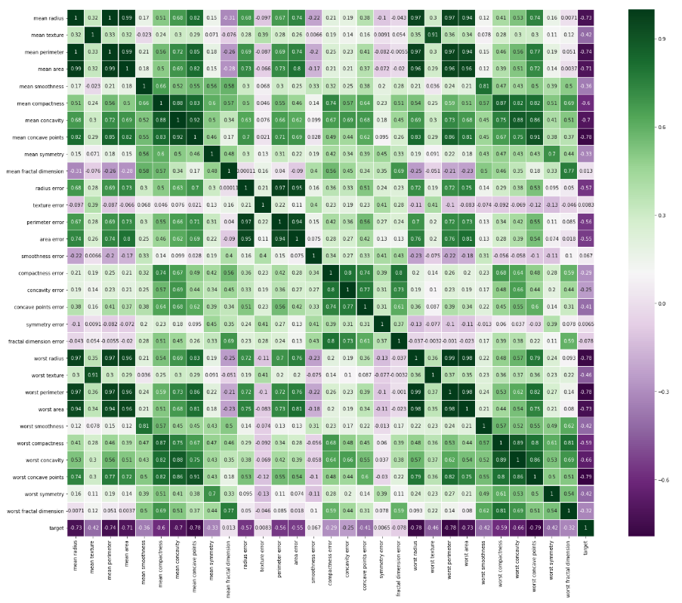
Heatmap : Through DecisionTreeClassifer method

Slide 5
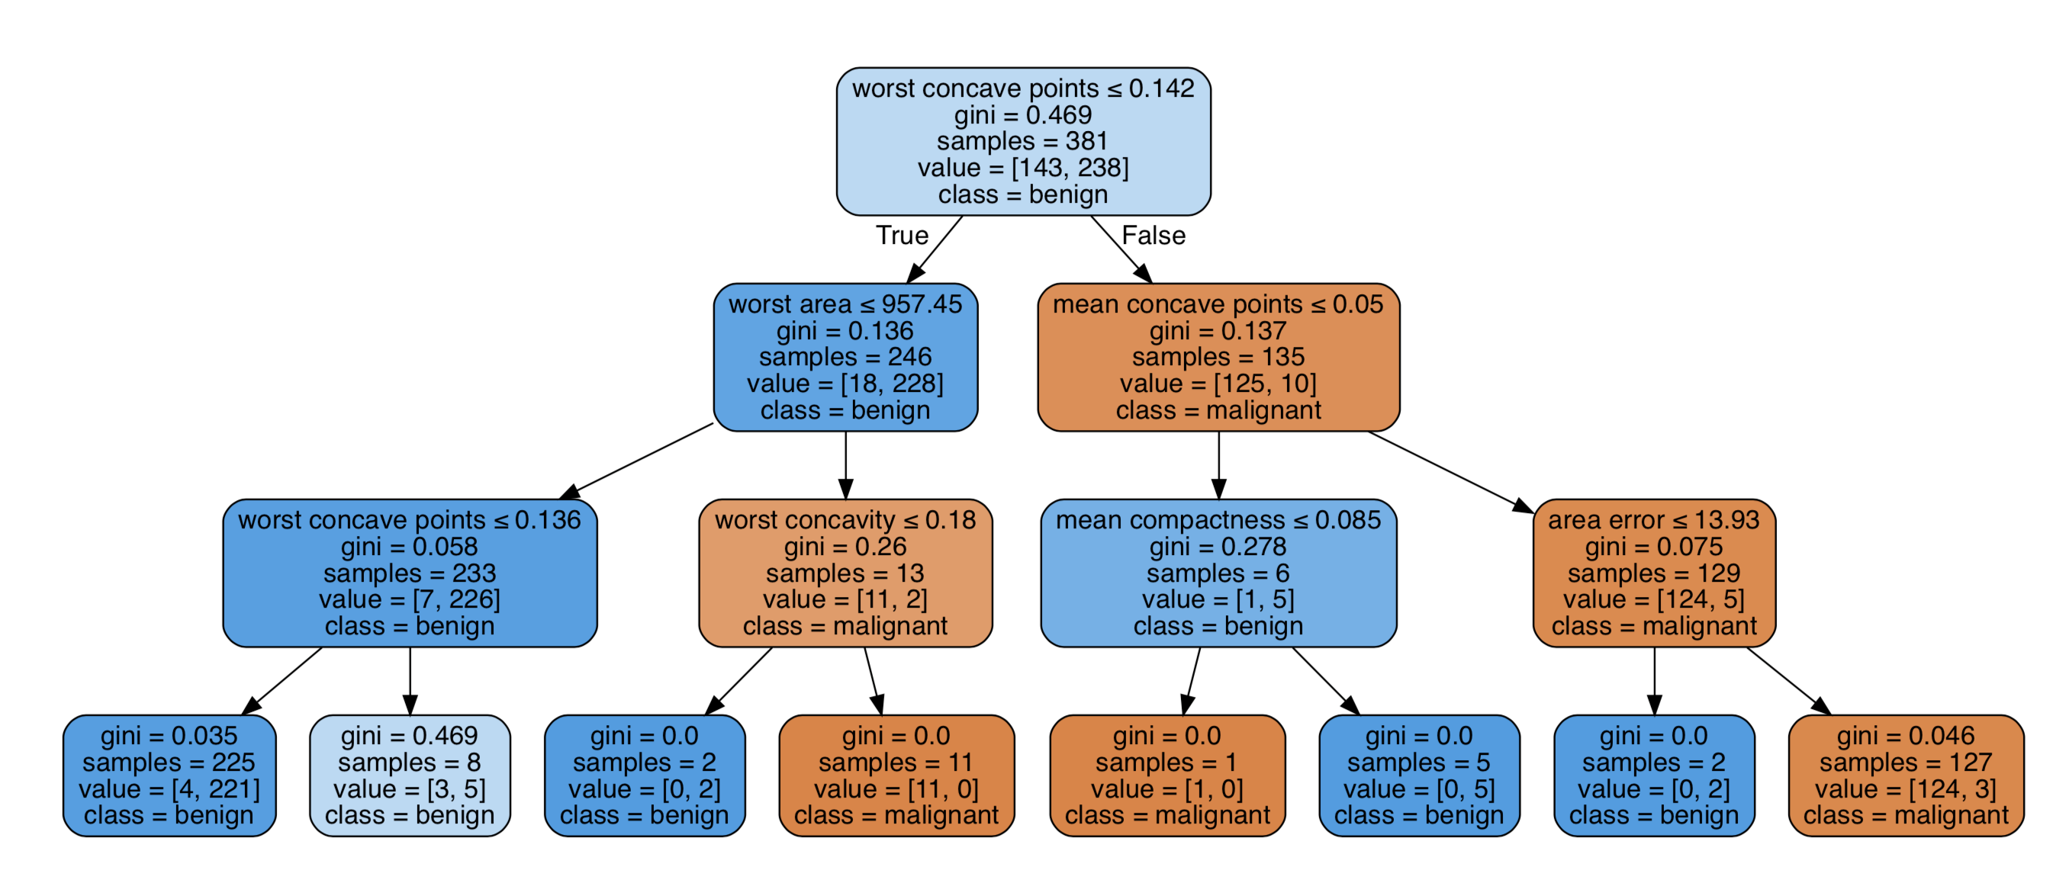
Graphviz : Through DecisionTreeClassifer method

Slide 6
Dataset(s)
Dataset -> https://scikit-learn.org/stable/modules/generated/sklearn.datasets.load_breast_cancer.html
Since the dataset is already in the sklearn.datasets, we can load it through the command of ‘from sklearn.datasets import load_breast_cancer’ in Juypter Notebook.

Slide 7
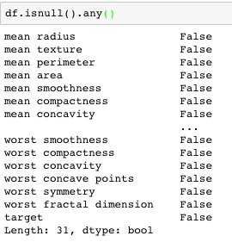
Data Preparation and Cleaning
First of all, check the data see if any row has null value on it by the command of ‘isnull().any()’. If yes, then use ‘dropna()’ function to clean the data.
In my case, I don’t see any null value.

Slide 8
Research Question(s)
Which characteristics have a high correlation to breast cancer?
Comparing two different supervised classification approaches, which one has a higher accuracy rate?
Using the unsupervised method, then compare accuracy rate to the above two supervised methods.

Slide 9
Methods
Supervised approach: DecisionTreeClassifier, KNN
Unsupervised approach: KMeans
Because they are simple algorithms, and our data only has two labels – benign and malignant.

Slide 10
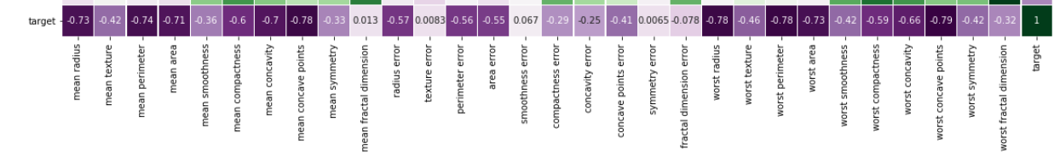
Findings & Conclusion
According to page 4 the heatmap result, we noticed the darker purple color has a higher correlation to breast cancer. In page 5, we also found the decision tree using these darker purple signs to classify benign or malignant.

Slide 11



Findings & Conclusion
 | DecisionTreeClassifier | KNN | KMeans
Accuracy rate | 94.14% | 94.68% | 15.95%
Confusion matrix
DecisionTreeClassifier and KNN has similar prediction result ~94%, but KMeans is obviously lower due to it is an unsupervised approach.

Slide 12
Limitations
The data only has two results – benign and malignant, which is easier for doing supervised data training.
However, I can foresee these two approaches won’t have that high of an accuracy rate (94%) when it has 3+ different results.

Slide 13
Acknowledgements
My friend suggested to me to use the KNN and KMeans approaches in this case due to our data being simple and belonging to the classification question.

Slide 14
References
Data: sklearn.datasets
I did this presentation on my own.

